Slide 1

Exploring the Impact of Meteorological Variables on Soil Moisture Using Explainable Artificial Intelligence (XAI)
Notes:
Good afternoon, everyone. I am Yizhou Pan. our project topic is Exploring the Impact of Meteorological Variables on Soil Moisture Using Explainable Artificial Intelligence (XAI). This project was completed by my team members, Jiajin and Peitao

Slide 2
OVERVIEW
01
Introduction
Background, Explainable AI (XAI), Project Objective
02
Methodology and Data
Roadmap, ML Methods, Study data and area
03
Results
Model Training, result analysis
04
Conclusion
Key Finding, Limitation, and Future work
Notes:
Here’s the structure of our presentation.

Slide 3

1. Introduction
Machine Learning in Modern Applications
The Black Box Problem in Machine Learning
The Importance of Explainable AI (XAI)
Objective of the Study
Notes:
let’s start with the introduction part.

Slide 4

Machine Learning in Modern Applications
High impact in real-world applications.
Improving decision-making through
data analysis.
Source: T. Logeswari, Machine learning: Enhancing the Perception of the Computer. International Journal of Engineering and Advanced Technology (IJEAT) ISSN: 2249 – 8958 (Online), Volume-9
Notes:
Here is a beautiful flower, showing the applications of machine learning. We can see that It's used in every aspect of our lives. However, as these models become more complex, they become less interpretable, creating what is known as the 'black box problem’.

Slide 5
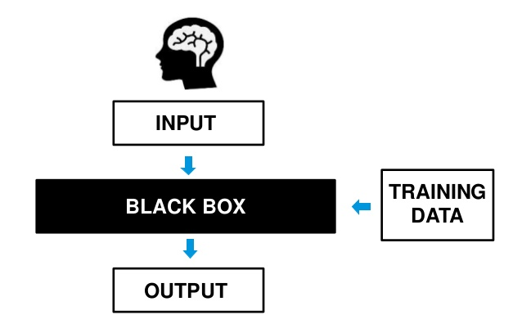
The Black Box Problem in Machine Learning
What is the Black Box Problem?
machine learning black box - The Data Scientist
Notes:
Machine learning models often produce predictions without providing clear explanations for their decisions.
Here’s a simple illustration showing the "black box" of ML—inputs (data) leading to outputs (predictions) without transparency.
However, This can be a significant issue, especially in critical fields where understanding the decision-making process is essential for trust and accountability(e.g., environmental science)

Slide 6
The Importance of Explainable AI (XAI)
XAI refers to methods that make machine learning models more interpretable and transparent.​
How models make decisions?
Which features have the most influence on their predictions
Notes:
This is where Explainable AI, or XAI, comes in. XAI consists of methods designed to make machine learning models more interpretable and transparent. It helps answer critical questions such as how models make decisions and which features are most influential.

Slide 7
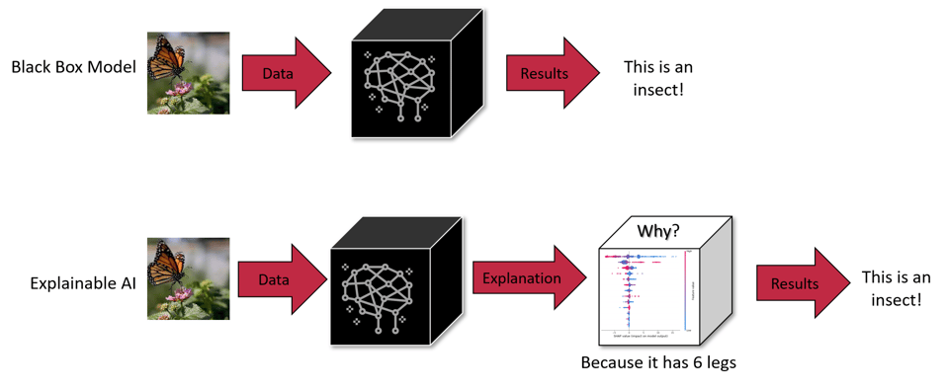
The Importance of Explainable AI (XAI)
Notes:
Here are flowcharts comparing a "black box" model versus an "explainable AI" model. We give a picture of butterfly to our model,

Slide 8
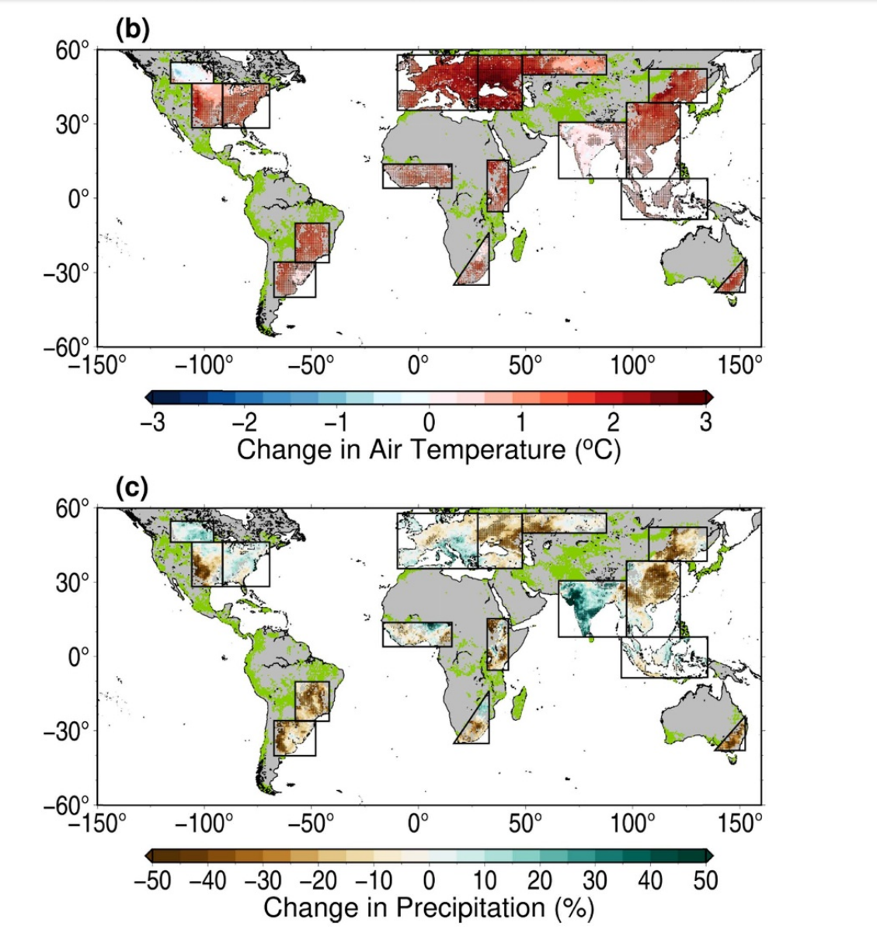
Why XAI Matters in Environmental Science
Environmental Applications:
  In fields like climate science and environmental modeling, understanding how and why models make specific predictions is crucial.
  The accuracy of predictions (e.g., soil moisture, temperature) can guide important decisions related to agriculture, water management, and climate adaptation.
Notes:
In environmental science, XAI is particularly valuable. This understanding can guide decisions in agriculture, water management, and climate adaptation.

Slide 9
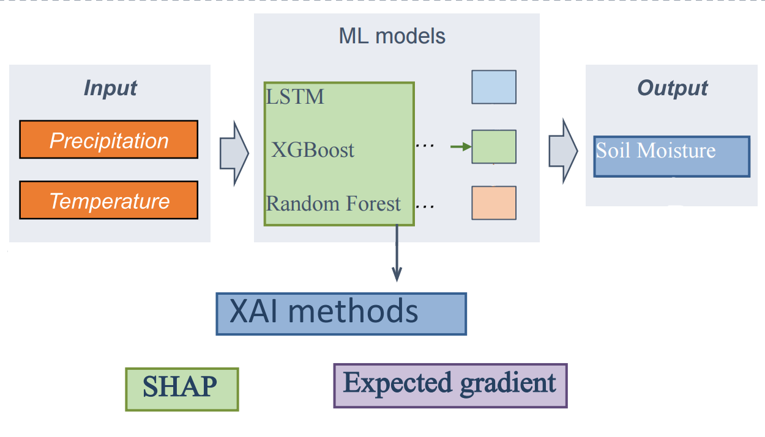
Objective of the Study
  1. Investigate how meteorological variables—precipitation and temperature—impact soil moisture predictions using machine learning models.
  2. Apply XAI techniques (e.g., SHAP) to interpret these models and understand the contribution of each variable to the predictions.
Notes:
The objectives of our study are twofold. First, we aim to investigate how precipitation and temperature impact soil moisture predictions using machine learning models, like LSTM, Xgboost, random forest. Second, we use XAI techniques, such as SHAP, to explain these models and quantify the contribution of each variable to the predictions.

Slide 10
2. Methodology and Data
Roadmap
Machine Learning Algorithms
Explainability Methods
Data Description
Study Area
Notes:
So now we move on to the methodology and data

Slide 11
Roadmap
Project Topic Discussion
and Goal Setting
Impact of precipitation and temperature on soil moisture
Data searching
ML Model Selection and Training
Machine Learning Models: XGBoost, Random Forest, LSTM
Model Training
Results Analysis
Analyze Results
Validate the model predictions
Week 1
Week 2
Week 3
Week 4
Week 5
2024.10
2024.11
2024.12
Data Collection and Preprocessing
Data Collection
Data Cleaning
Data Splitting
Explainability Analysis
Model Evaluation
Use SHAP for Explanation
Reporting and Presentation
Prepare Presentation
Write Report
Notes:
Here’s the roadmap for our project. We used three machine learning algorithms for this study.

Slide 12
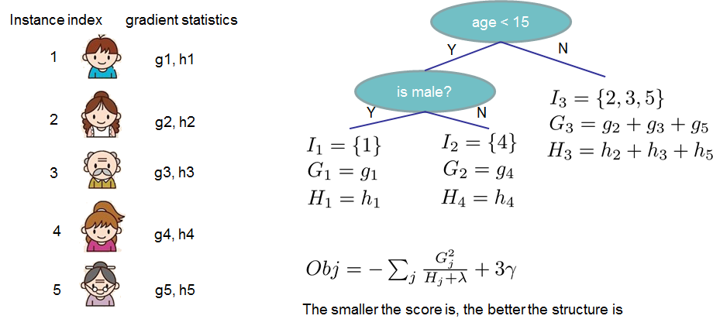

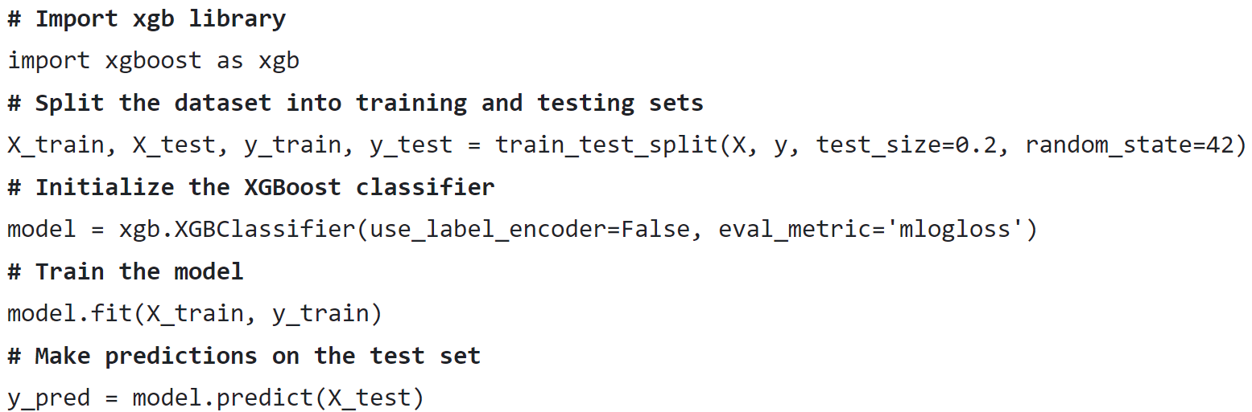
Machine Learning Algorithms
XGBoost (Extreme Gradient Boosting) ^{[1]}
Based on decision trees (classification and regression)
Good at handling large datasets
Predicting complex interactions between variables
[1] XGBoost Documentation - https://xgboost.readthedocs.io/en/stable/index.html
Notes:
The first one is XGBoost, which is an efficient tree-based model suitable for large datasets.
Here is a simple example and sample code to demonstrate how to use it.

Slide 13

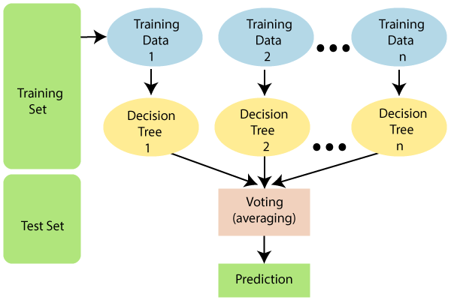
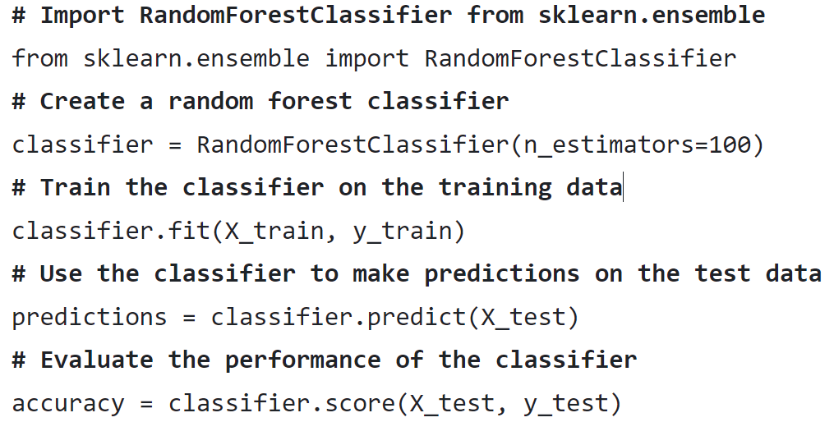
Machine Learning Algorithms
Random Forest ^{[2]}
Supervised ML algorithm (classification and regression)
  Combine multiple decision trees to create a “Forest”
  Vote on the predictions of each decision tree
  Determine the final output.
Advantages:
  high accuracy, prevents overfitting issues
  runs efficiently on large datasets
  handle high-dimensional data
[2] Scikit-learn.Ensemble/Random Forest - https://scikit-learn.org/1.5/modules/generated/sklearn.ensemble.RandomForestClassifier.html
Notes:
The second one is Random Forest, it's also based on decision trees method, but it can handle high-dimensional data well.
Also, a simple code for demonstration.

Slide 14
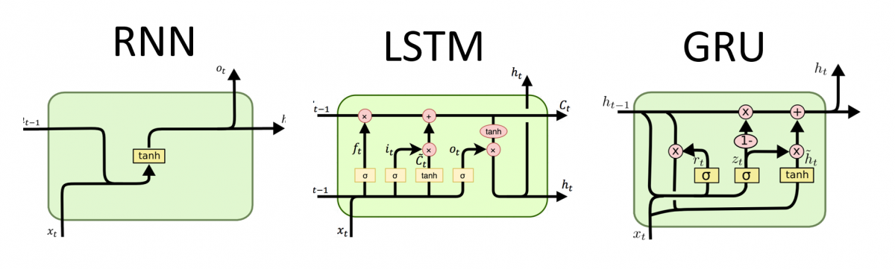
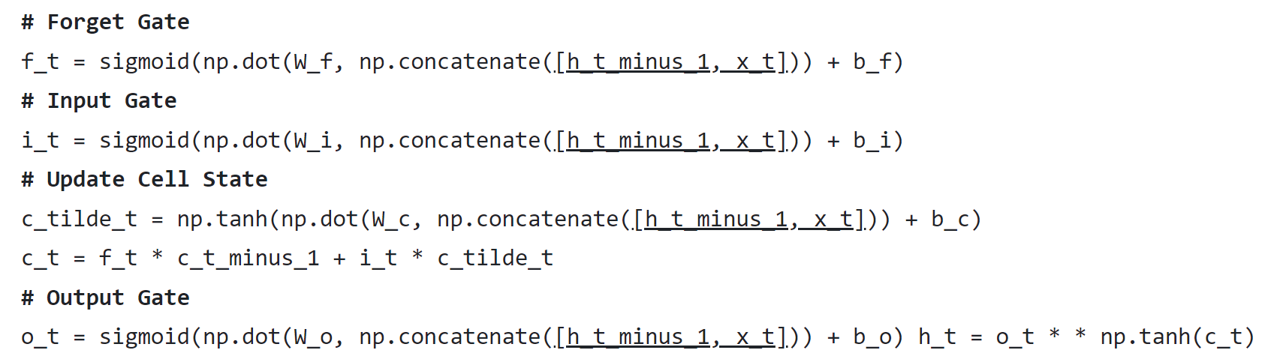
Machine Learning Algorithms
LSTM (Long Short-Term Memory) ^{[3]}
Modified Recurrent Neural Network (RNN)
  input gate: Controls how much input to store.
  forget gate: Determines which data needs to be forgotten or retained.
  output gate: Decides which data is passed to the next step as output.
Advantages:
  handling and predicting time-series data
  Widely used in weather forecasting and NLP
[3] Recurrent Neural Network (RNN), Long-Short Term Memory (LSTM) - http://dprogrammer.org/rnn-lstm-gru
Notes:
The last one is LSTM, a type of recurrent neural network, which is ideal for time-series data and it's widely used in weather forecasting and NLP.

Slide 15
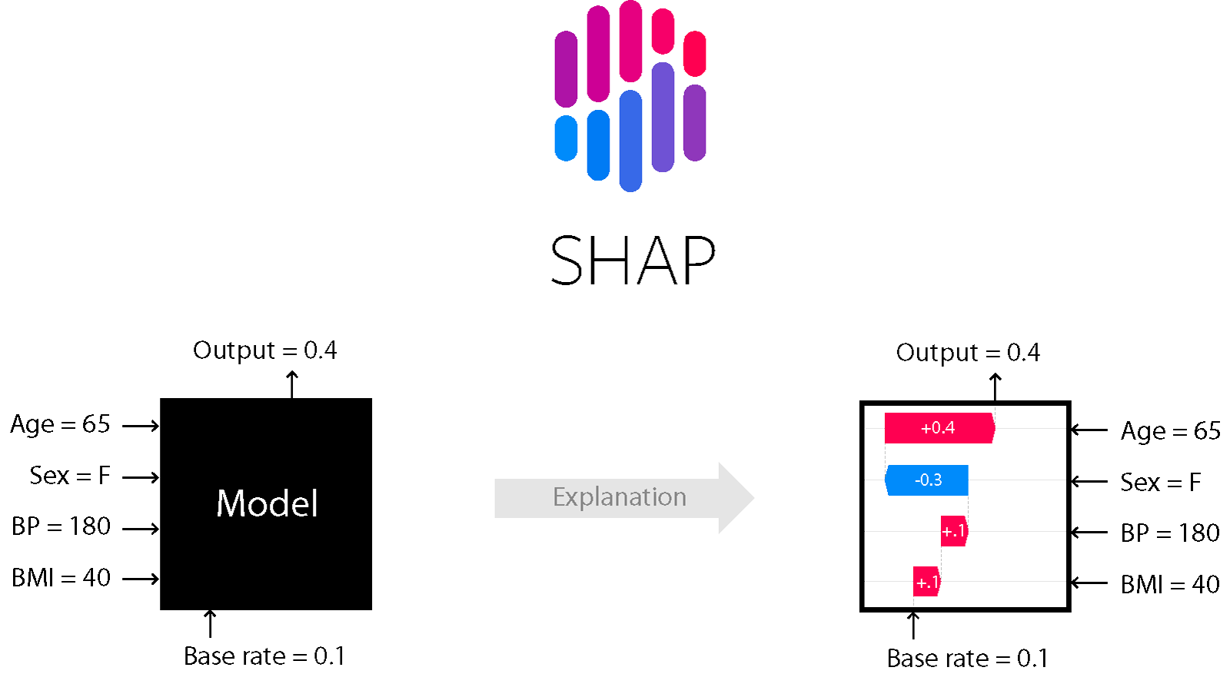
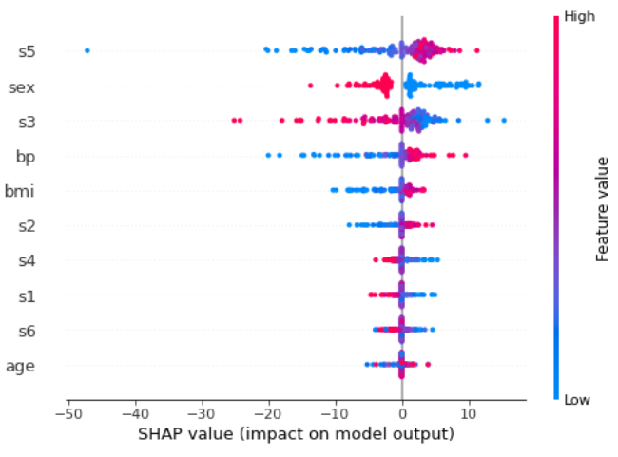
Explainability Methods
SHAP (SHapley Additive exPlanations) Framework ^{[4]}
Based on game theory to explain the predictions of ML models
Additivity: The sum of SHAP values equals the difference between the model's prediction and the average prediction.
Use 2 Explainers in the project: shap.TreeExplainer and shap.GradientExplainer.
Summary plot: each point of every row is a record of the test dataset.
  The higher the value of the feature, the more positive the impact on the target.
  The lower this value, the more negative the contribution.
[4] SHAP (SHapley Additive exPlanations) documentation - https://shap.readthedocs.io/en/latest/
Notes:
To interpret the models, we used SHAP,shapley additive explanations, it includes a powerful python package. We use it to explain the predictions of ML models
It assigns a value to each feature, explaining its contribution to the model's prediction.

Slide 16
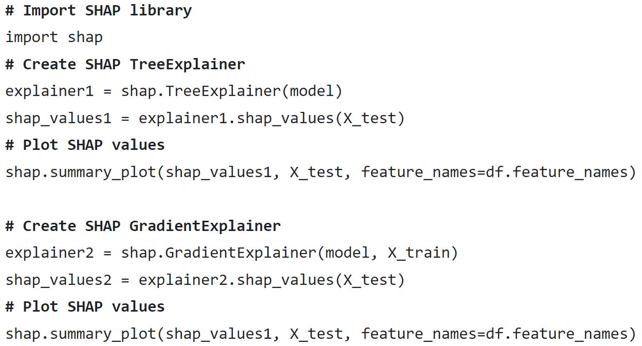
Explainability Methods
SHAP (SHapley Additive exPlanations) Framework ^{[4]}
a) shap.TreeExplainer ^{[5]}
Designed for tree models (including individual trees and ensemble tree models)
Used to explain results using XGBoost and Random Forest (tree-based models).
b) shap.GradientExplainer^{[5]}
Suited for neural networks models, using gradient information to explain the model’s output.
Used to explain results using LSTM (recurrent neural network - RNN).
[5] SHAP documentation - Explainers - https://shap.readthedocs.io/en/latest/api.html#explainers
Notes:
For tree-based models like XGBoost and Random Forest, we used TreeExplainer.
For the LSTM model, we used GradientExplainer, which suited for neural networks models.

Slide 17
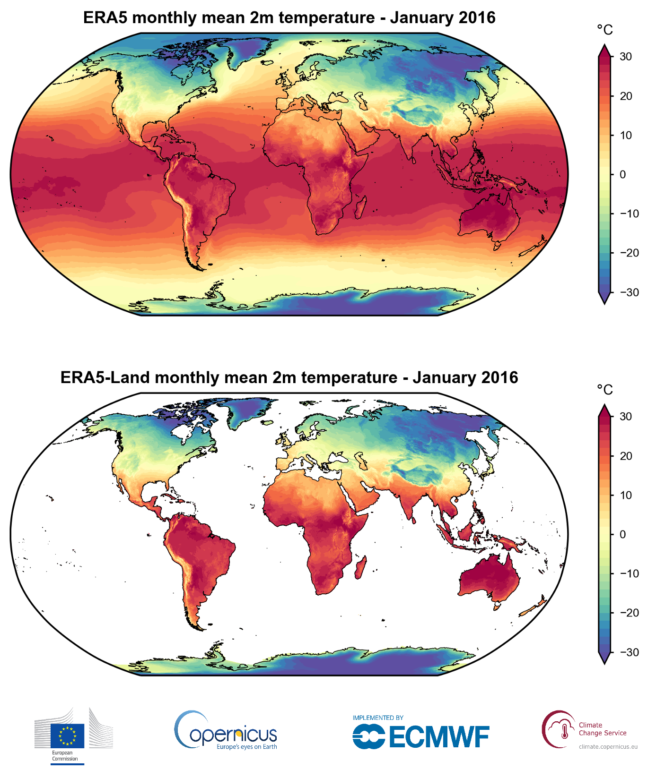
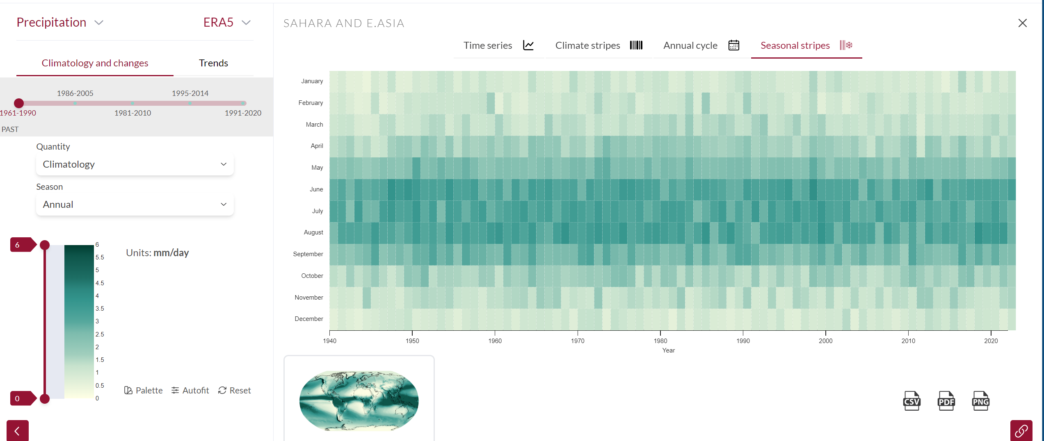
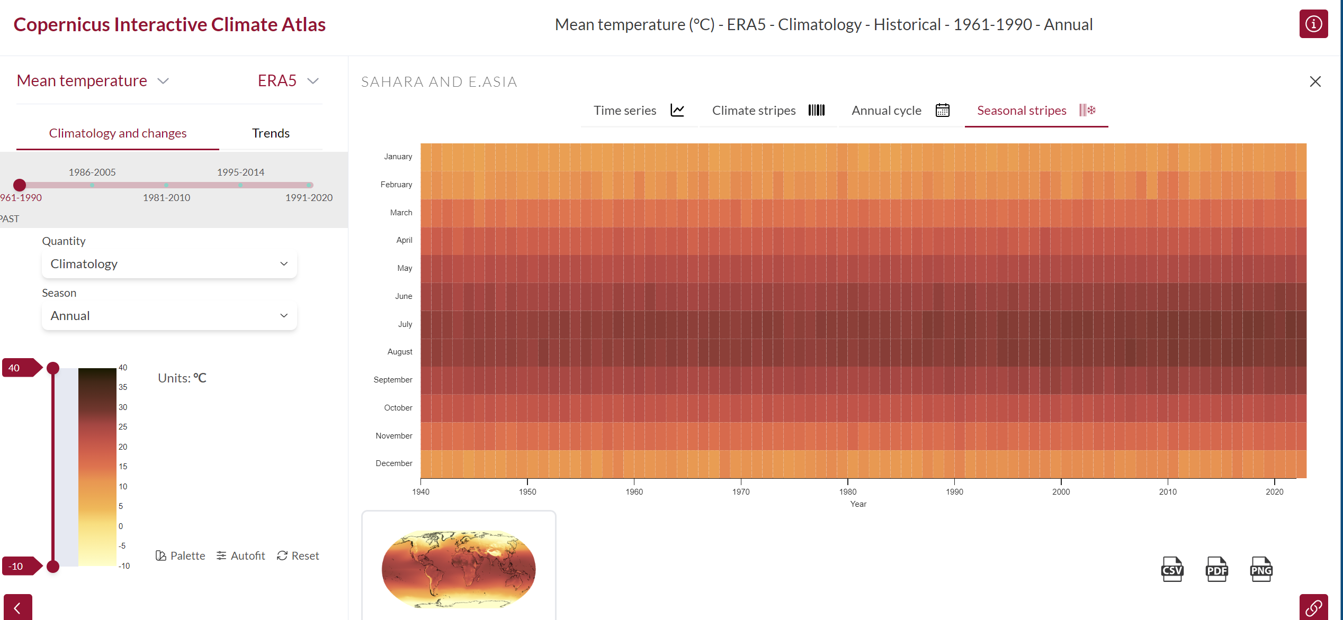
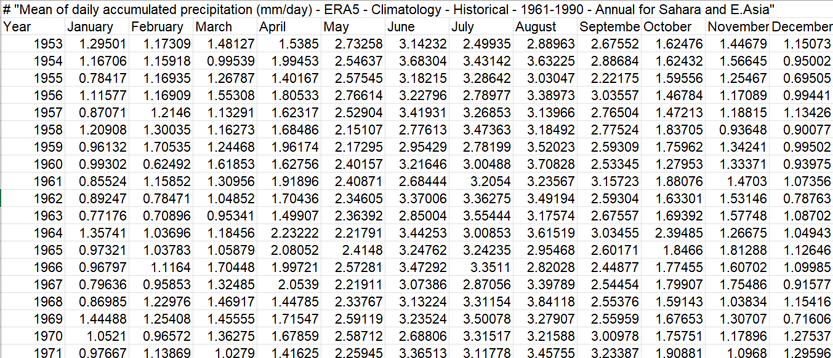
Data Description
a) ERA5 Monthly Averaged Reanalysis ^{[6-7]}
Time Period: From 1950 to 2023 (888 months)
Global Climate Data, variables include:
  Total Precipitation: Monthly precipitation data.
  2m Temperature: Air temperature at 2 meters above ground level.
  Volumetric Soil Water Layer 1, 2, 3: Soil moisture content in three different layers of soil. These values are weighted and combined to represent 1-meter soil moisture.
Focus: how Precipitation and Temperature influence Soil Moisture.
[6] Climate Data Store - https://cds.climate.copernicus.eu/datasets/reanalysis-era5-single-levels-monthly-means?tab=overview
[7] ERA5: data documentation - https://confluence.ecmwf.int/display/CKB/ERA5
Notes:
Our primary dataset was ERA5 Monthly dataset [the European Centre for Medium-Range Weather Forecasts (ECMWF) atmospheric reanalysis for the global climate]
a comprehensive environmental dataset for the global climate.
We just used variables such as monthly precipitation, 2-meter air temperature, and soil moisture at different depths.

Slide 18
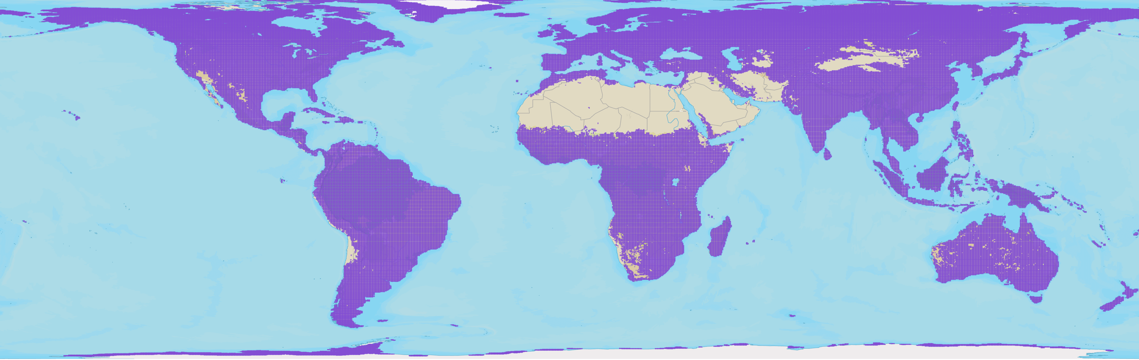
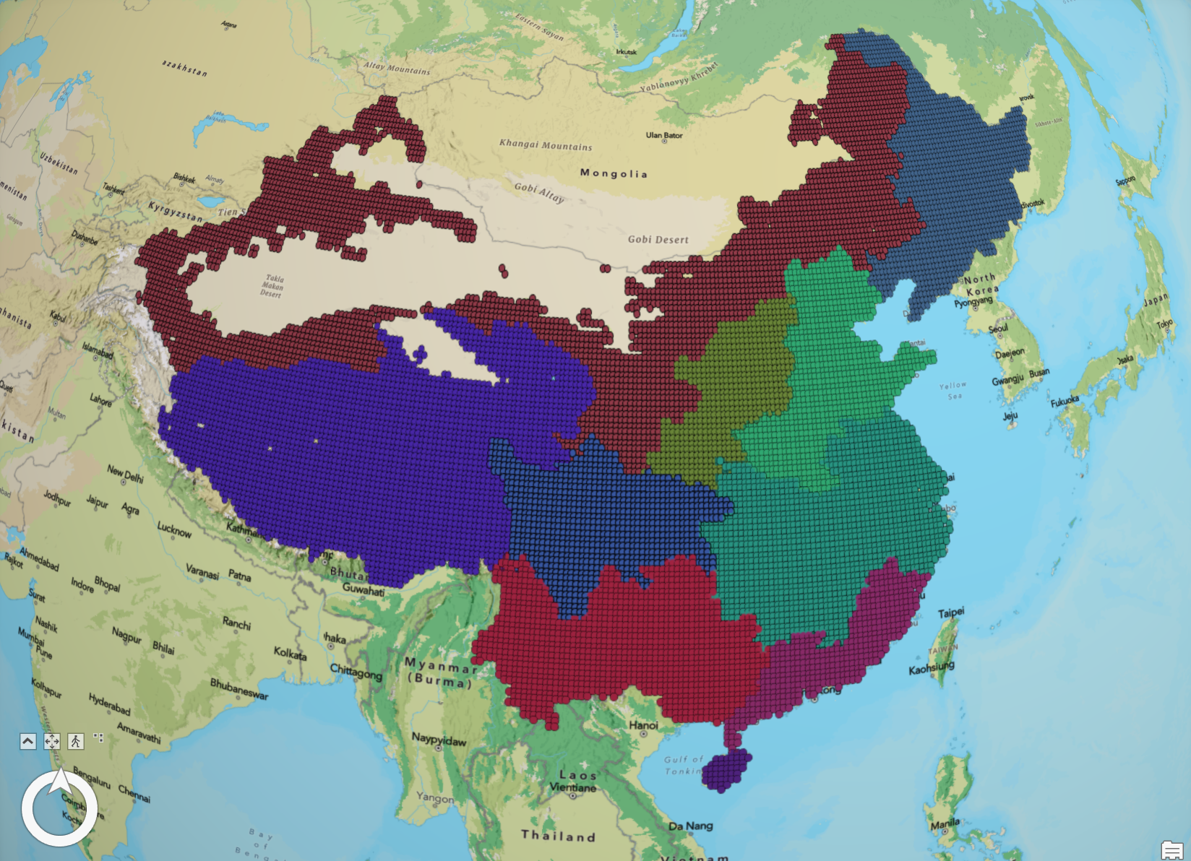
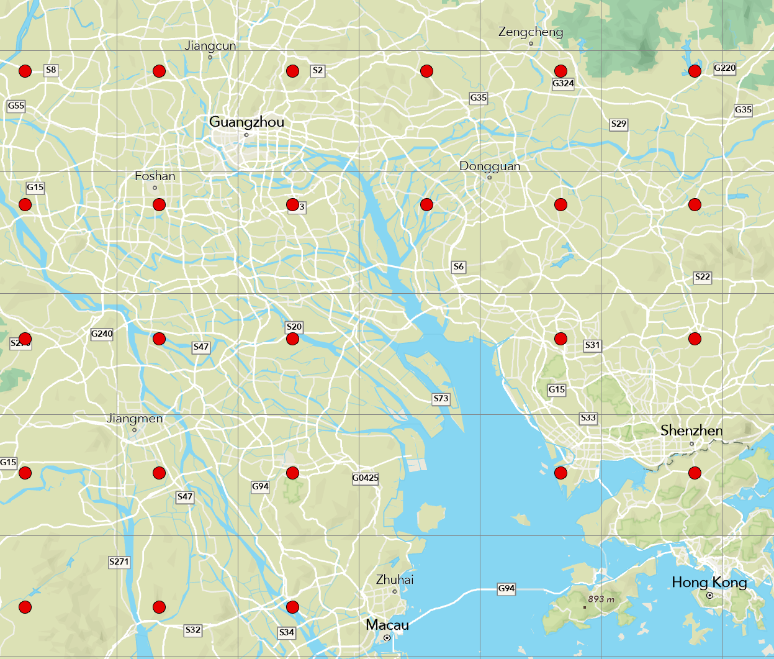
Study Area
b) Agricultural Areas of China ^{[8-9]}
Location: Mainland China
Sub-area: Divide into 10 area according to the ten major agricultural areas in China, each area divided into multiple 0.25°grid cells.
[8] Resource and Environmental Science Data Platform of China - https://www.resdc.cn/data.aspx?DATAID=275
[9] USGS U.S. Geological Survey / NASA's Land Processes Distributed Active Archive Center - https://www.usgs.gov/apps/croplands/downloadLPDAAC
Notes:
We focused on 10 agricultural zones in mainland China, each divided into smaller grid cells.

Slide 19
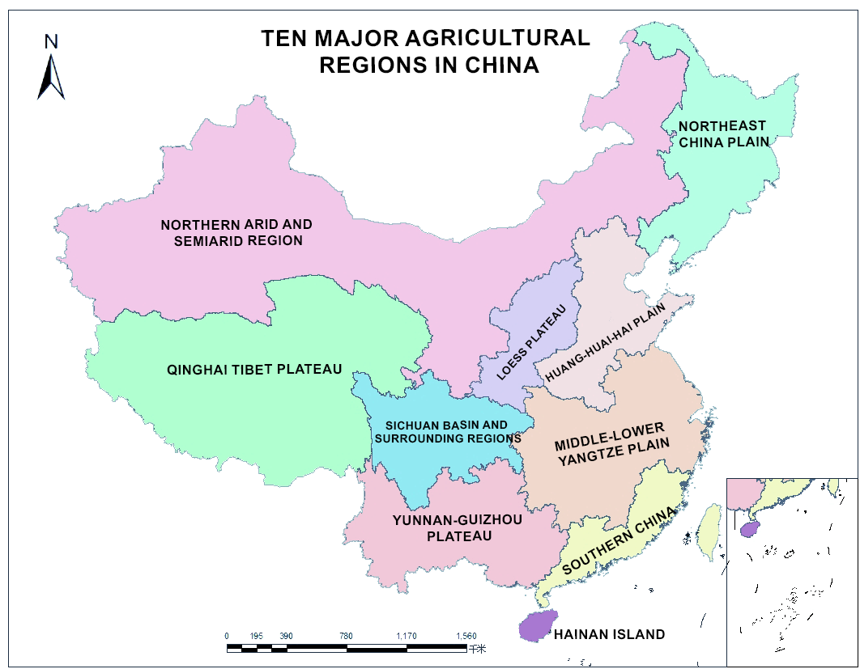
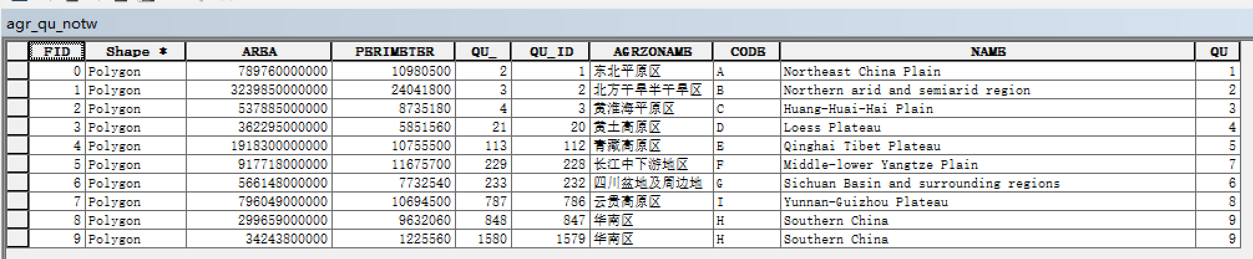
Study Area
b) Agricultural Areas of China ^{[8-9]}
Location: Mainland China
Sub-area: Divide into 10 area according to the ten major agricultural areas in China, each area divided into multiple 0.25°grid cells.
Modeling Approach: Built individual ML models for each sub-area, resulting in 10 models per algorithm.
  Localized Predictions: Localized models capture regional characteristics more accurately.
  Improved Accuracy: Smaller datasets allow models to detect local patterns and variations, enhancing accuracy.
[8] Resource and Environmental Science Data Platform of China - https://www.resdc.cn/data.aspx?DATAID=275
[9] USGS U.S. Geological Survey / NASA's Land Processes Distributed Active Archive Center - https://www.usgs.gov/apps/croplands/downloadLPDAAC
Notes:
By building localized models for each zone, we were able to capture regional patterns more effectively.
This approach improves accuracy and reflects the unique characteristics of each area.
So next, my teammate Jiajin will introduce the training process and the interesting results we got.

Slide 20
3. Result
Model Training
XAI Results
Notes:
Here, I’m going to introduce the results and conclusions of the project
First is how we train the model with the datasets mentioned before
And then how we coupled the models we just built with XAI algorithms, to do the explanations

Slide 21
Model Training
RF & XGB
P₋₅ | P₋₄ | P₋₃ | P₋₂ | P₋₁ | P₀
T₋₅ | T₋₄ | T₋₃ | T₋₂ | T₋₁ | T₀
Model inputs:
X: Precipitation and Temperature
y: soil moisture
Time steps:
RF & XGB: 6 months
LSTM: 12 months
Training and Validation
Data in all grid cells of a sub-areas were concatenated to train one ML model
First 80% of data in each grid cell: training sets
Last 20% of data in each grid cell: validation sets
Predict
SM₀
SM₀
LSTM
Predict
P₋₁₁ | P₋₁₀ | P₋₉ | P₋₈ | P₋₇ | P₋₆ | P₋₅ | P₋₄ | P₋₃ | P₋₂ | P₋₁ | P₀
T₋₁₁ | T₋₁₀ | T₋₉ | T₋₈ | T₋₇ | T₋₆ | T₋₅ | T₋₄ | T₋₃ | T₋₂ | T₋₁ | T₀
Notes:
First is the model training
Here we use precipitation and temperature as input features
And the target output is soil moisture
When we train the model, we use a time window to generate X, input features, dataset
For RF and XGB models, the window is 6 months, and for LSTM the window is 12 month
For example, if we want to predict the SM at a certain month, let’s call it SM zero,
Then we need the precipitation and temperature of the zero month, to the minus five month
For lstm model, it is P zero to P minus eleven
Since we have many grid cells in each sub area, we concatenate the X and y data grid cell,
And put them into the model for trainings
In addition, we split the dataset into training sets and validation sets:
The first 80% of data of each grid cell is selected as training sets
And the last 20% of data in each grid cell is used as validation sets

Slide 22
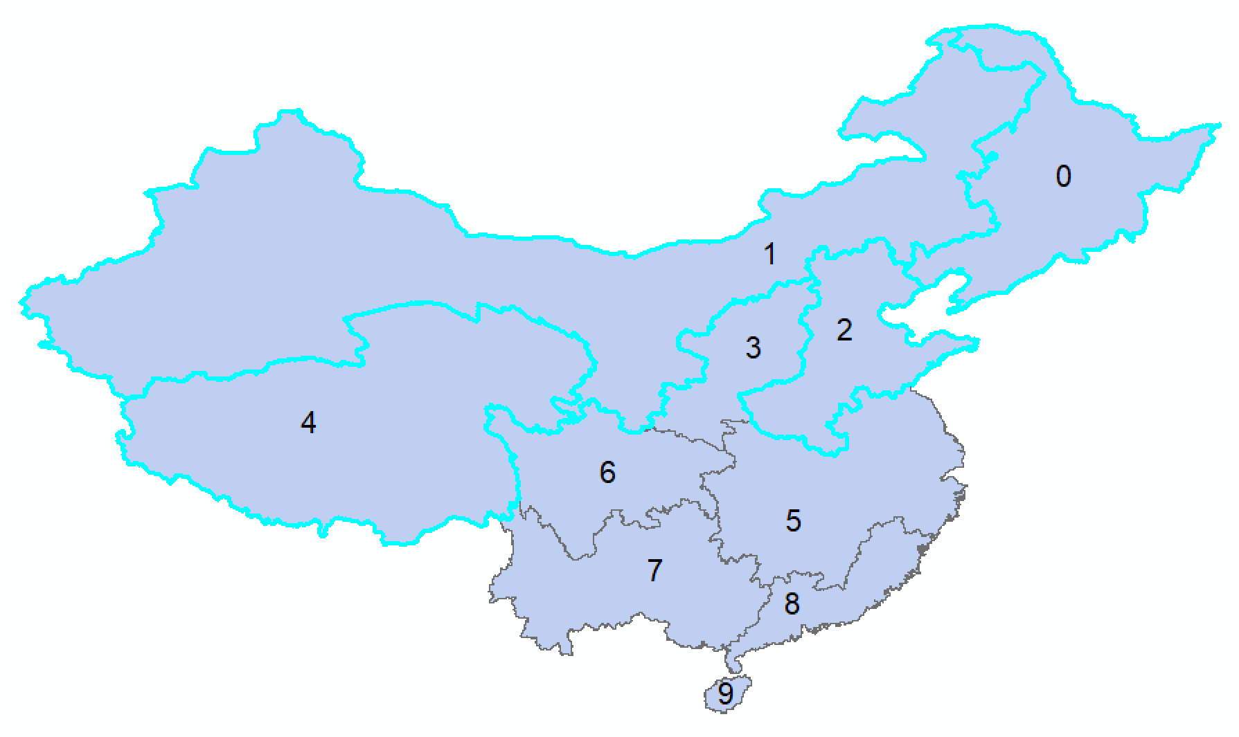
Model Training
LSTM models achieve the best results
Models in northern and western China generally perform worse than in southern China
Possible reasons:
Areas occupy large geographical ranges, makes ML models difficult to capture the patterns.
The soil moisture in Tibetan Plateau (Area 4) is influenced by complicated frozen soil mechanisms, makes ML model difficult to predict SM with meteorological variables.
Arid and Semi-arid areas (Areas 1) typically have sparse and inconsistent rainfall, leading to limited variability in the data.
R² for testing set
Sub-areas | RF | XGB | LSTM
0 | 0.411 | 0.467 | 0.5063
1 | 0.2664 | 0.2958 | 0.3354
2 | 0.2493 | 0.318 | 0.3769
3 | 0.5307 | 0.5894 | 0.5999
4 | 0.3868 | 0.4154 | 0.4627
5 | 0.5971 | 0.6326 | 0.6633
6 | 0.4769 | 0.5333 | 0.5644
7 | 0.6269 | 0.656 | 0.6987
8 | 0.6291 | 0.6505 | 0.649
9 | 0.6064 | 0.6157 | 0.6575
Notes:
Here is the model training training and validation results
Overall, LSTM achieves the best results among the three machina learning algorithms
Among the ten sub-areas, 7 areas have an R squared greater than 0.5
One interesting results is that the models generally performs not good in sub-areas in northern and western China
And the possible reason is that:

Slide 23
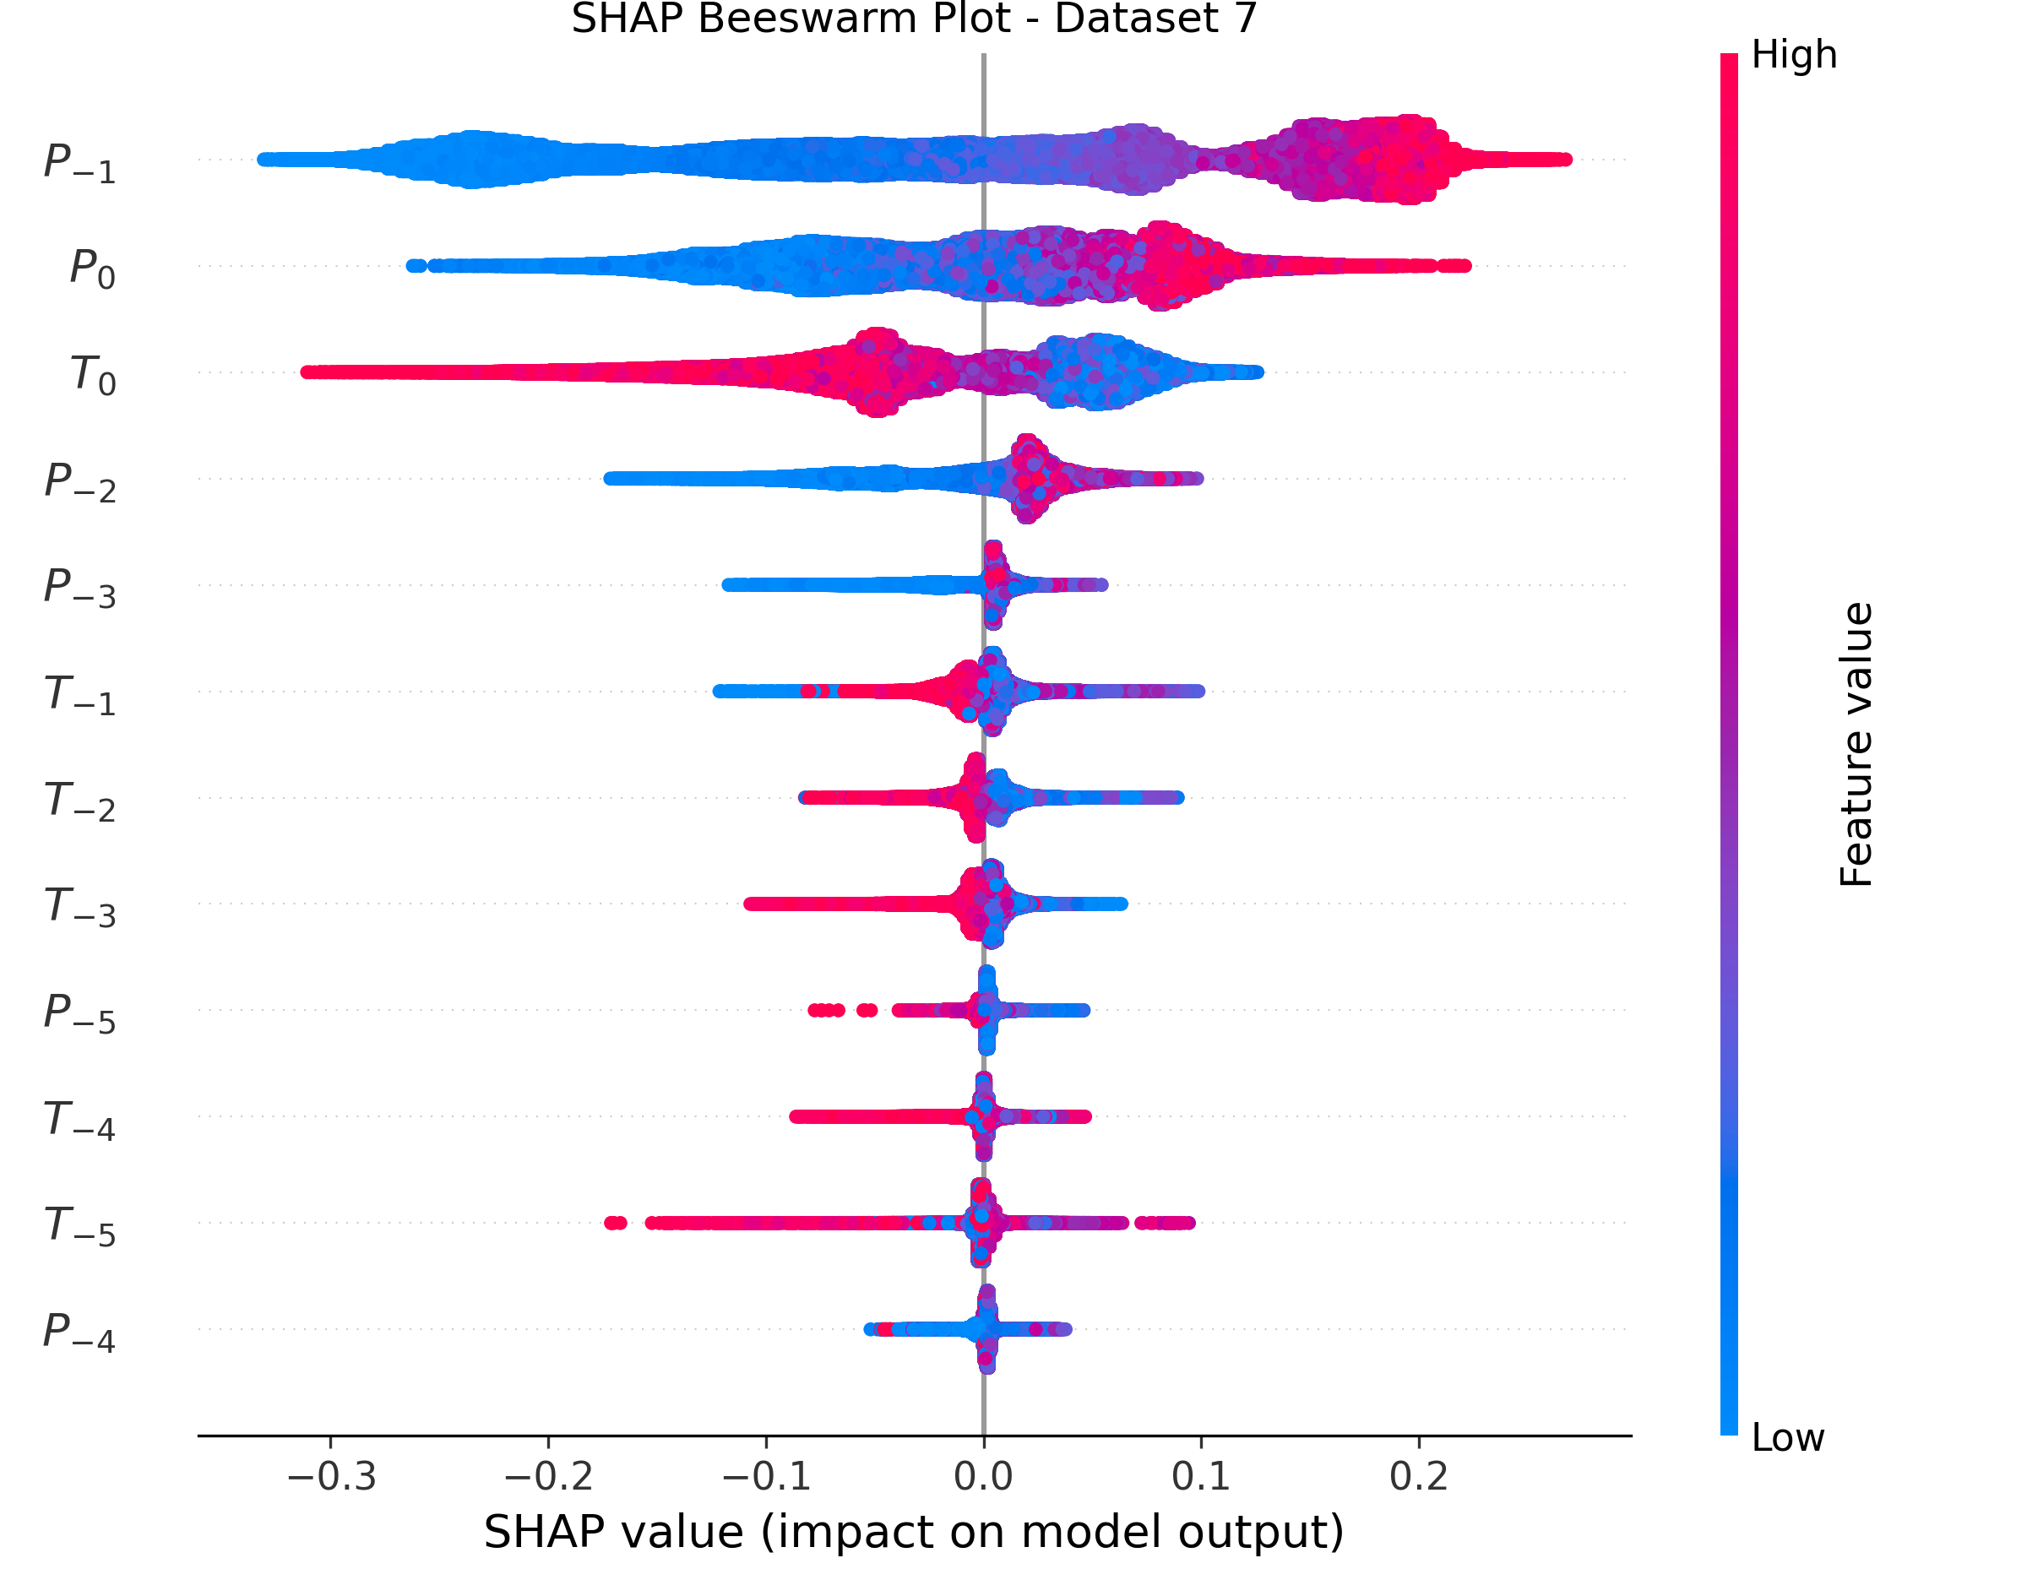
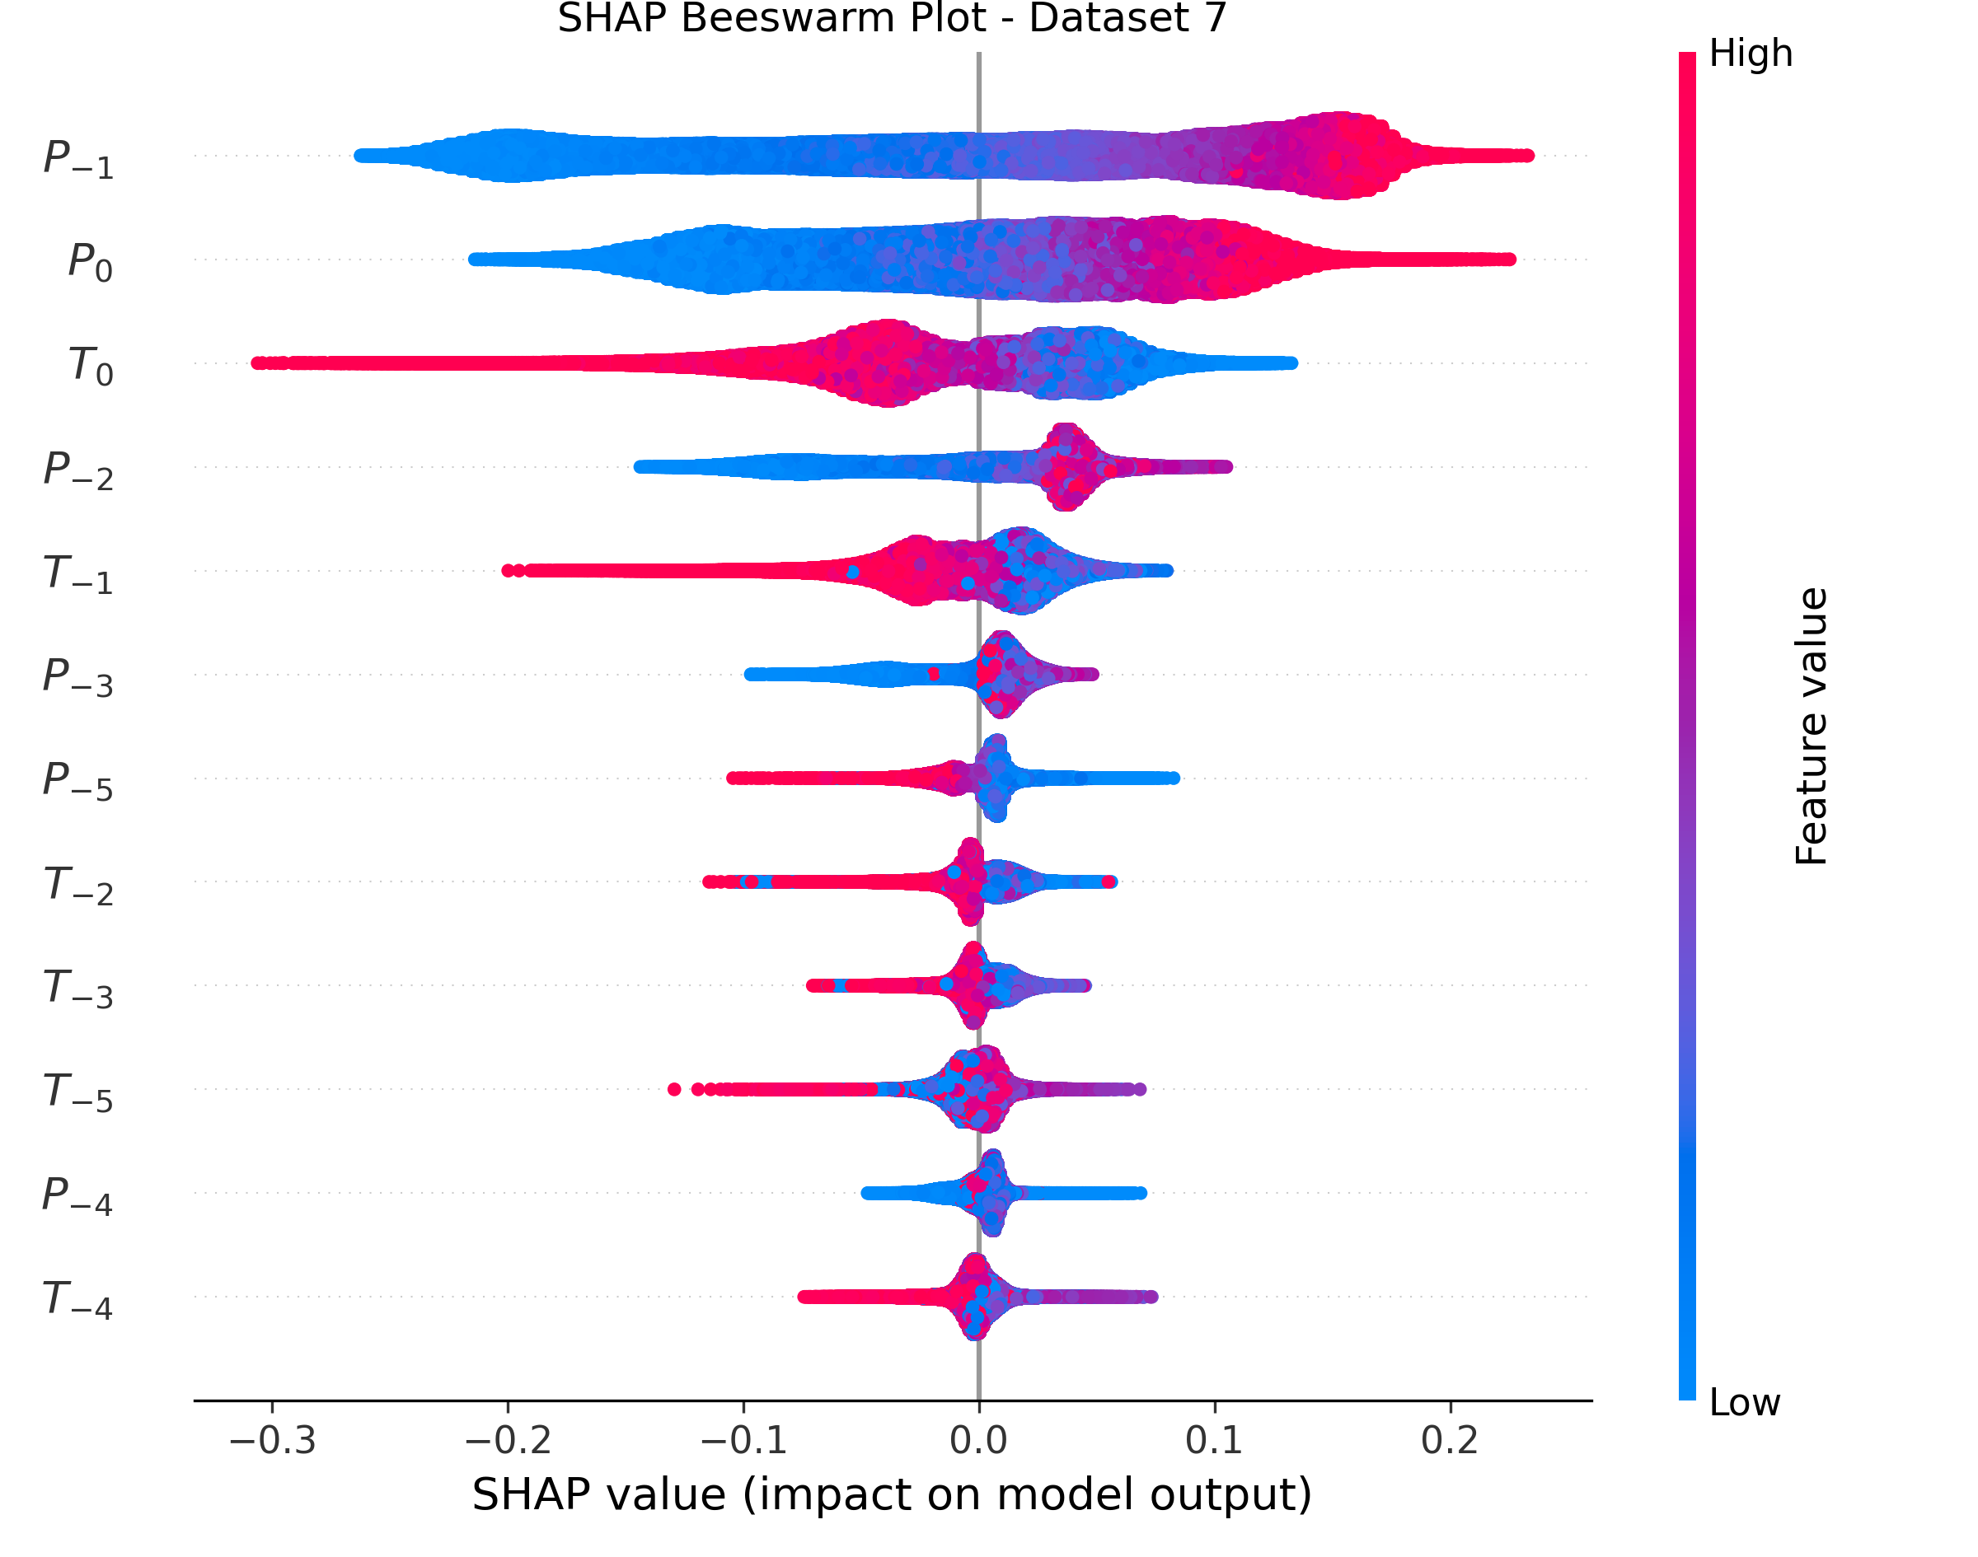
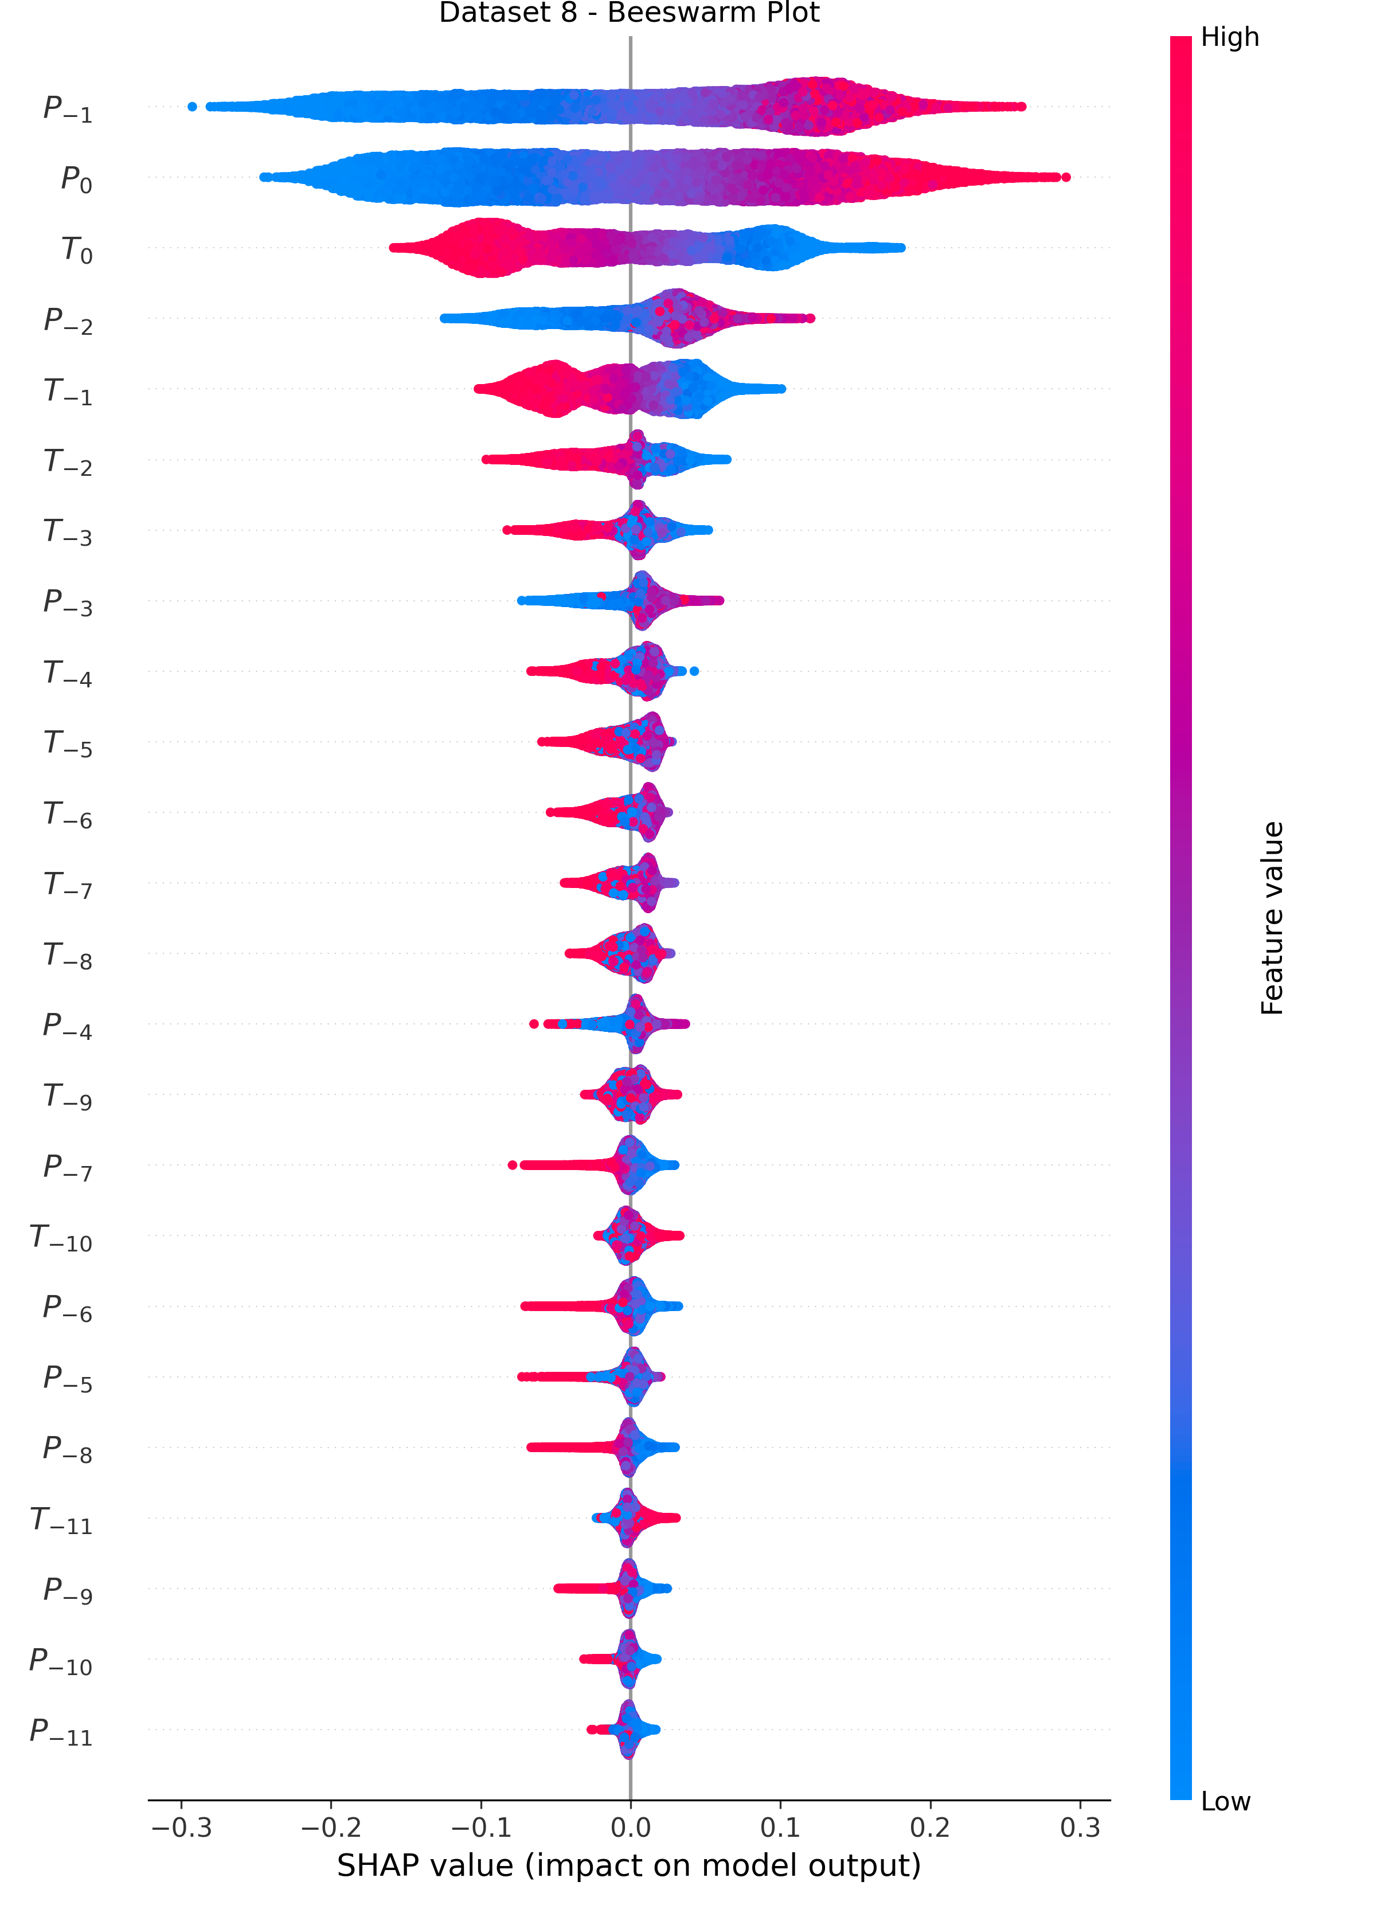
XAI Results
SHAP models explain results
Precipitation generally shows a greater impact on soil moisture than temperature
High P→High SM; Low P→Low SM; High T→Low SM; (Low T impact on SM is modest);
In most of the models, P₋₁ demonstrates the largest impact on soil moisture
Possible reason: lagged effect of P’s impact on SM, which requires more than one month of high P (or low P) to induce high SM (or low SM)
RF (TreeExplainer)
XGB (TreeExplainer)
LSTM (GradientExplainer)
SHAP beeswarm plots
(Sub-area 7)
Notes:
Let’s move to the XAI parts,
After we train the models,
we coupled the ML models with XAI algorithms in SHAP library on Python
We only apply XAI algorithms on models that have an R squared greater than 0.5.
For two tree-based model, the random forest and XGB, we use TreeExplainer, for LSTM, we use GradientExplainer
Here, we show the explanation results from three different ML model in one certain area
Here I’m going to briefly introduce the beeswarm plots
One interesting finding is that

Slide 24
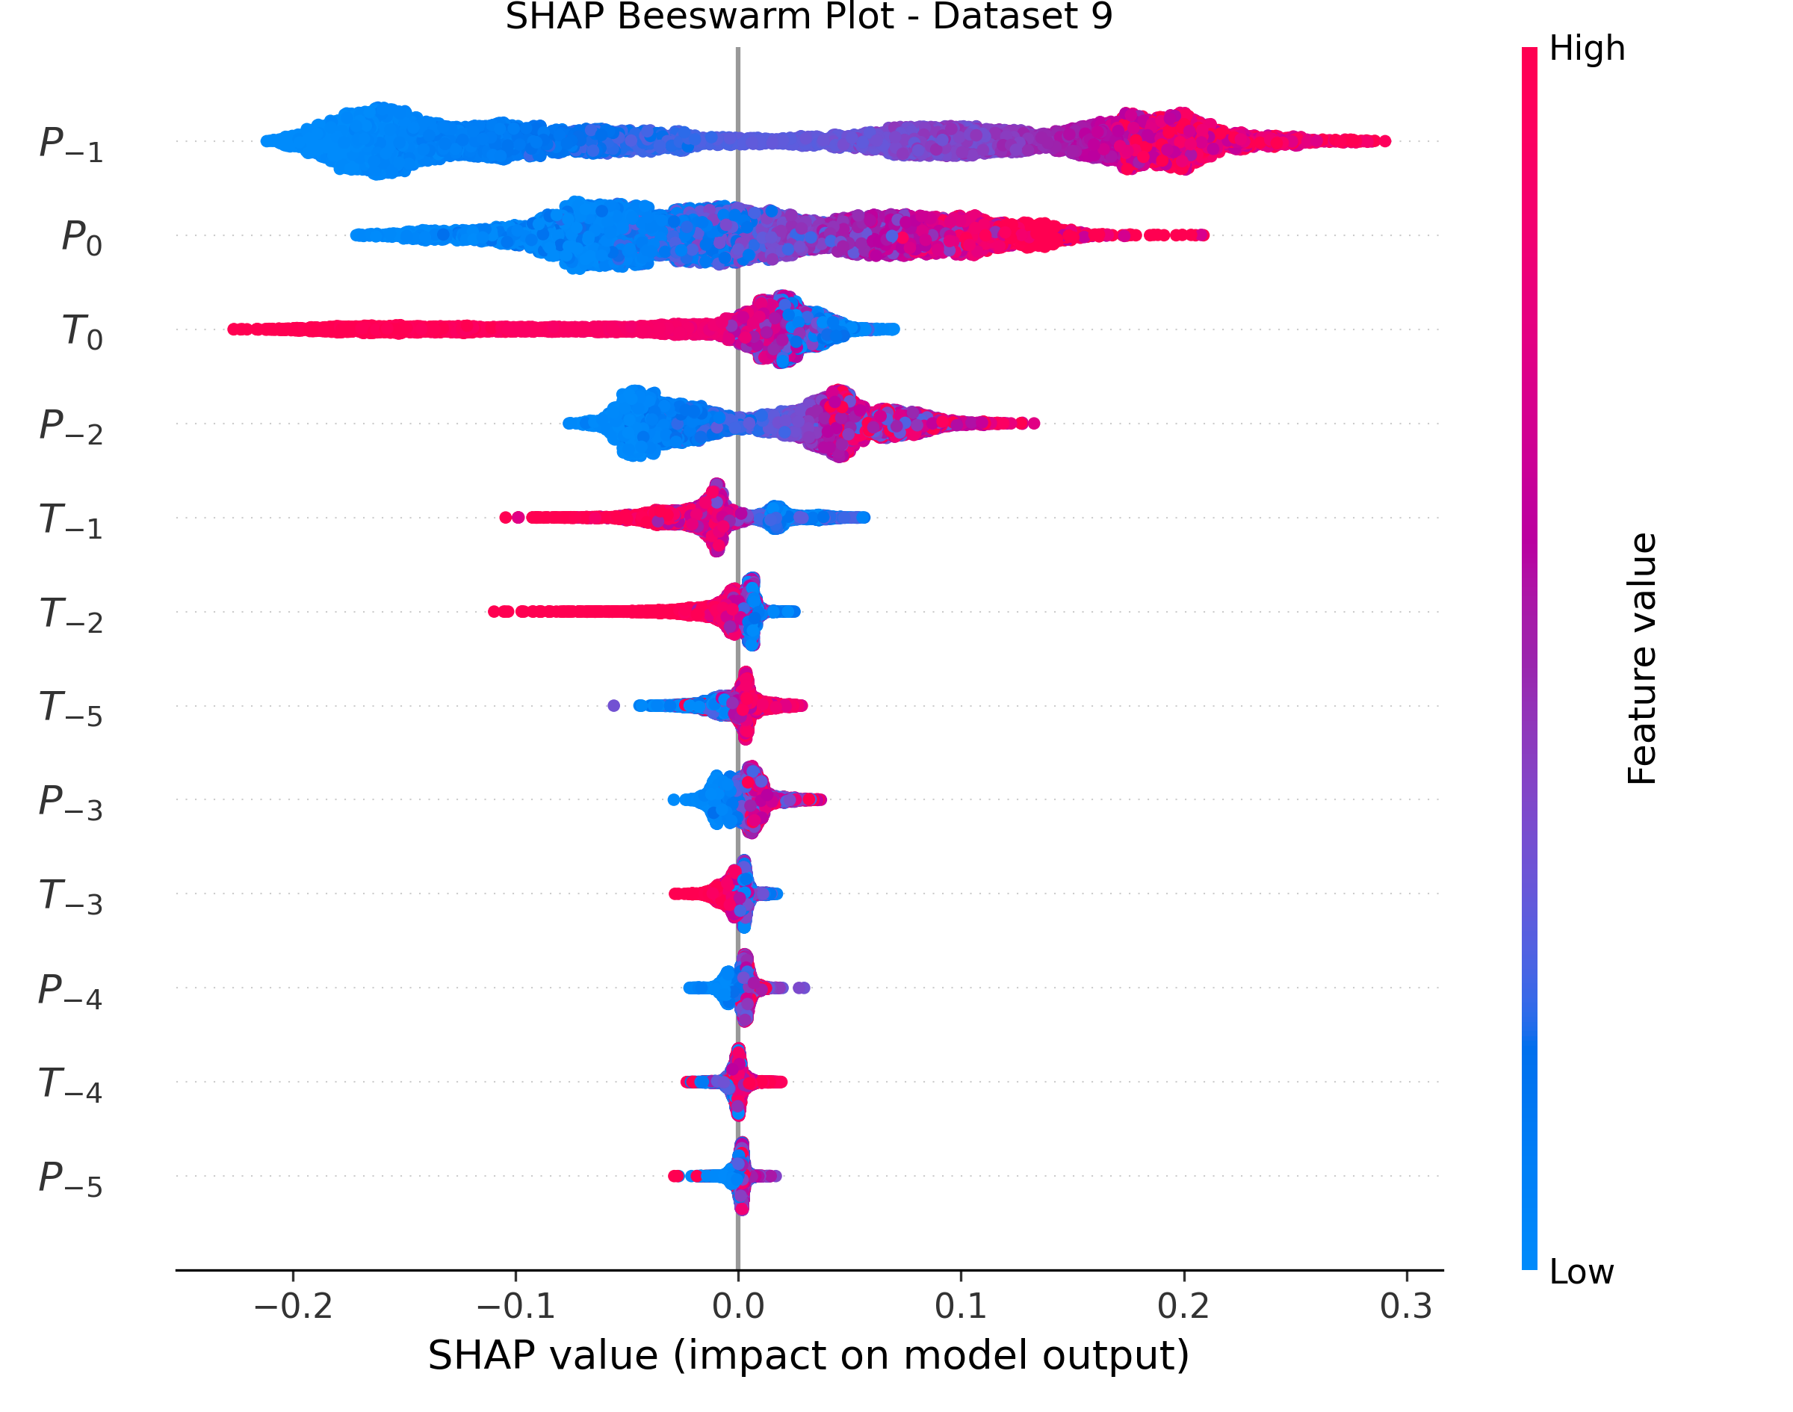
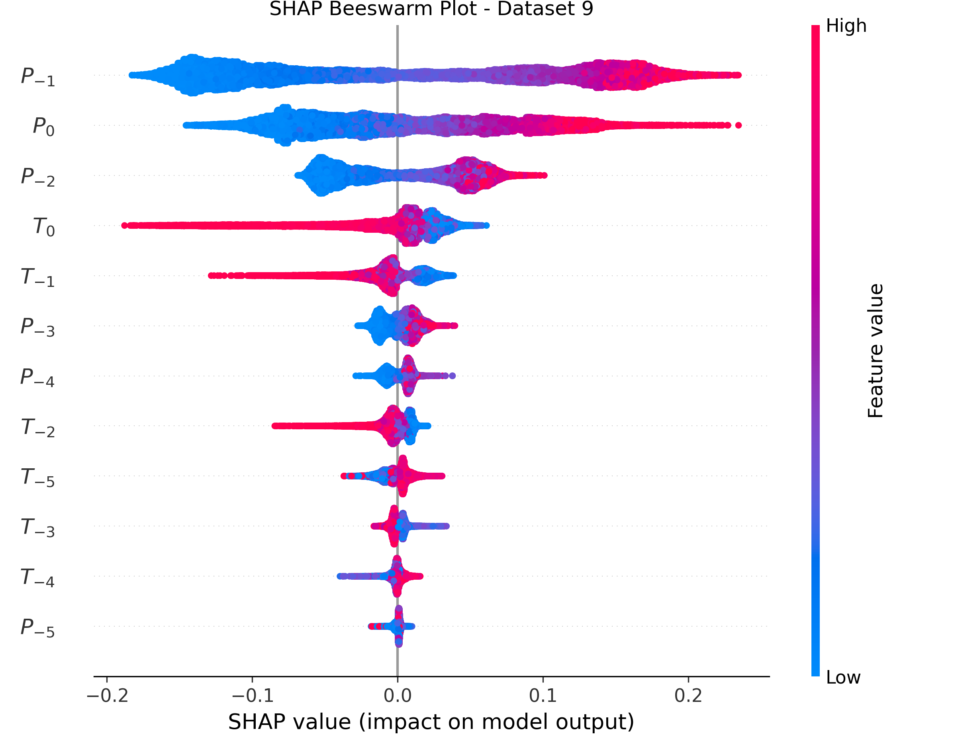
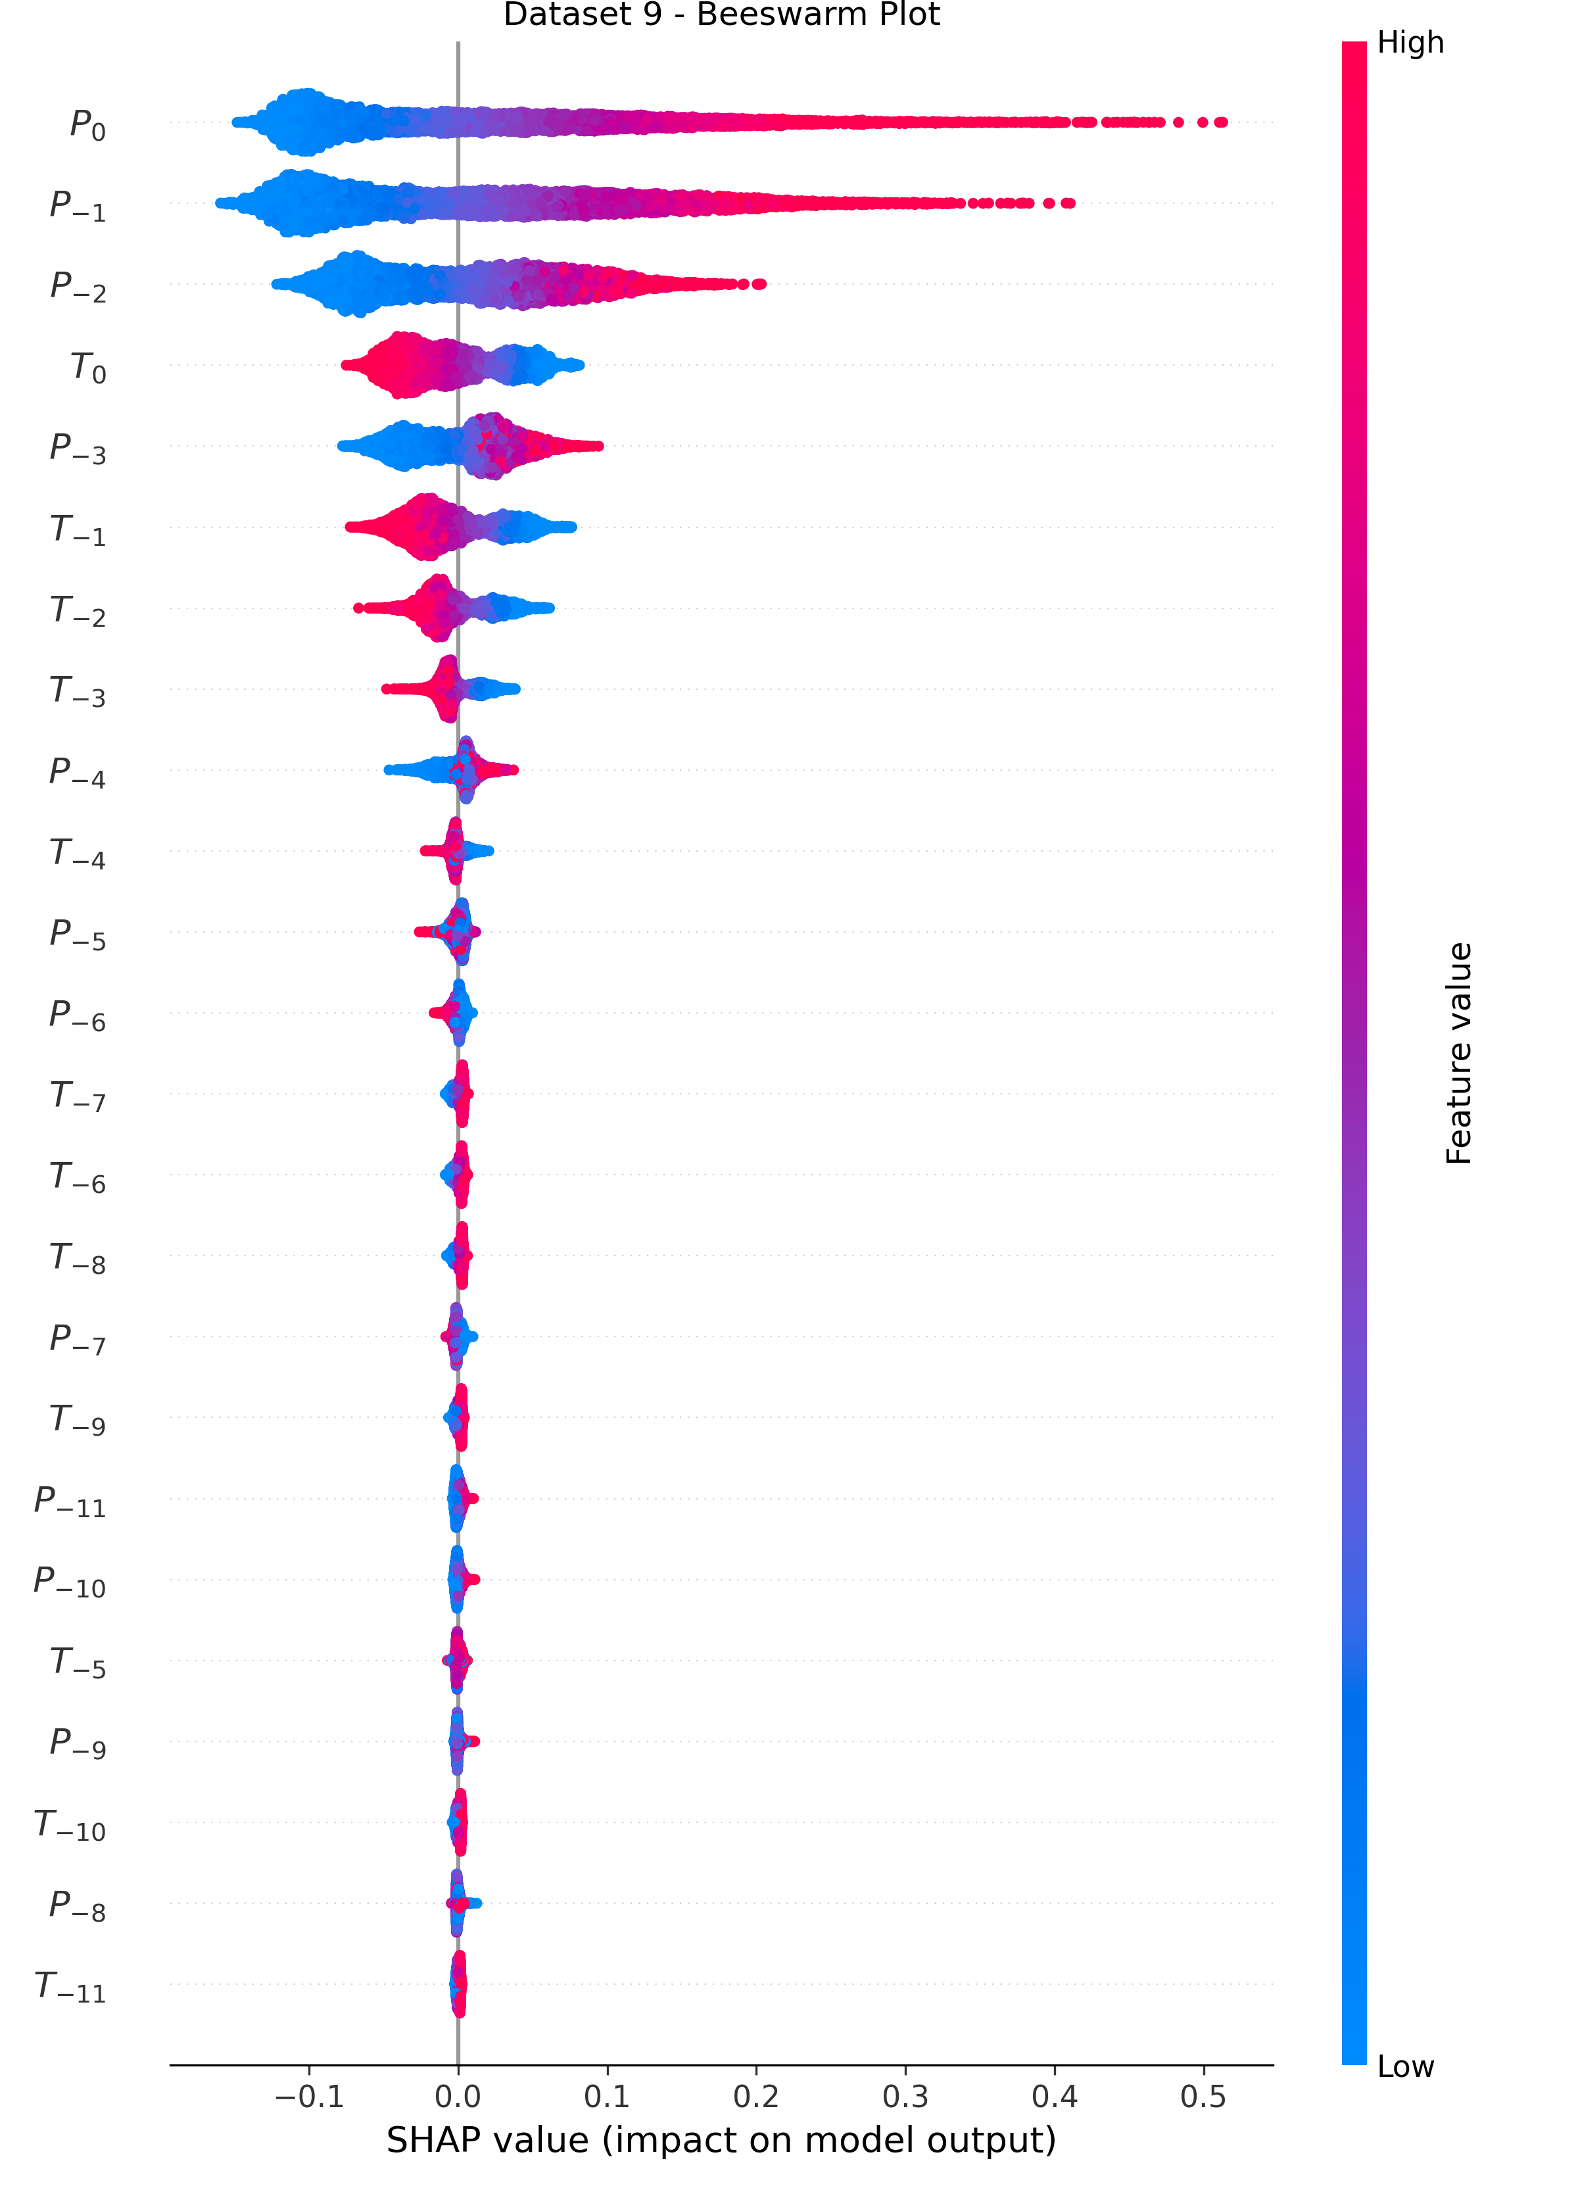
XAI Results
Some inconsistent explain results
Model structure
XAI datasets: RF&XGB: full datasets; LSTM: only testing sets
RF (TreeExplainer)
XGB (TreeExplainer)
LSTM (GradientExplainer)
SHAP beeswarm plots
(Sub-area 9)
Notes:
However, some models also show inconsistent results
For example, in sub-area 9,
The explanation results from LSTM models shows that high P have a significant positive impact on SM
But low P only has a modest negative impact on SM
However, RF and XGB shows a different results

Slide 25
Conclusion

Slide 26
Conclusion
Findings:
LSTM models perform better than two simpler tree-based models
High (low) precipitation has a significant positive (negative) impact on soil moisture
High temperature has a significant negative impact on soil moisture, while low temperature demonstrate a modest positive impact on soil moisture
Most models explain results demonstrate a lagged effect of precipitation’s impact on soils moisture
Limitations:
Model validation results in certain regions are not satisfactory
In certain regions, XAI results are not consistent
Future Work:
Use more accurate data, such as in-site soil moisture observations
Include more variables that potentially impact soil moisture in models (vegetation, wind speed, ground water, etc.)
Data-driven method → Physics-informed ML methods

